Slide 1



Unit 4
Tree
Prof. Brijesh Vala, Assistant Professor
Computer Science & Engineering

Slide 2


Topic-1
Tree

Slide 3
Objectives
At the end of this unit, you will be able to understand the:
basic tree terminologies (concepts)
Various types of trees
Various operation perform on binary trees

Slide 4

Nature View of a Tree
leaves
branches
root

Slide 5

Computer Scientist’s View
root
leaves
branches
nodes

Slide 6
Basic Tree Concepts
A tree is a non-linear data structure. A tree consists of finite set of elements (one or more), called nodes, and a finite set of directed lines called branches, that connect the nodes.
Tree is an acyclic digraph.
The elements are connected in such a way that there are no loops.
There is only a unique path from source to destination in a tree.

Slide 7
Basic Tree Concepts
When the branch is directed toward the node, it is indegree branch.
When the branch is directed away from the node, it is an outdegree branch.
The sum of the indegree and outdegree branches is the degree of the node.
If the tree is not empty, the first node is called the root.

Slide 8
Basic Tree Concepts
Root node is the first node in the hierarchical arrangement. There can be only one root in the tree.
Parent node is an immediate predecessor of a node.
The immediate successors are called child.

Slide 9
Basic Tree Concepts
Root: node without any parent (A)
Degree(B)=3
A
B
C
D
E
F
G
H
I
J
K

Slide 10
Basic Tree Concepts
The in-degree of the root is zero.
With the exception of the root, all of the nodes in a tree must have an in-degree of exactly one; that is, they may have only one predecessor.
All nodes in the tree can have out-degree of zero, one, or more.

Slide 11
Basic Tree Concepts
A leaf is any node with an out-degree of zero, that is, a node with no successors. (a node without any further child node)
A node that is not a root or a leaf is known as an internal node.
A node is a parent if it has successor nodes; that is, if it has outdegree greater than zero.
A node with a predecessor is called a child.

Slide 12
Basic Tree Concepts
leaf: i,j,k,e,g,h,d
Internal: b,c,f
Parent: root+any internal node (A,B,C,F)
Child: except root node A
A
B
C
D
E
F
G
H
I
J
K

Slide 13
Basic Tree Concepts
Two or more nodes with the same parents are called siblings.
An ancestor is any node in the path from the root to the node.
A descendant is any node in the path below the parent node; that is, all nodes in the paths from a given node to a leaf are descendants of that node.

Slide 14
Basic Tree Concepts
Sibling: c,d
Ancestor(f):b,a
Descendant(f):i,j,k
A
B
C
D
E
F
G
H
I
J
K

Slide 15
Basic Tree Concepts
A path is a sequence of nodes in which each node is adjacent to the next node. It is number of successive edges from source node to destination node.
The level of a node is its distance from the root. The root is at level 0, its children are at level 1, etc. …

Slide 16
Basic Tree Concepts
Path(B,K):BFK
LEVEL(G):2
A
B
C
D
E
F
G
H
I
J
K

Slide 17
Basic Tree Concepts
The height of the tree is the total number of levels in the tree.
The depth of the tree is last(max) level number of the tree.
A sub-tree is any connected structure below the root. The first node in the subtree is known as the root of the subtree.

Slide 18
Basic Tree Concepts
HEIGHT:4
DEPTH: 3
A
B
C
D
E
F
G
H
SUBTREE
I
J
K

Slide 19
Different types of Trees
Binary tree
Threaded Binary Tree
Binary Search Tree
AVL Tree
B Tree
B+ Tree
2-3 Tree

Slide 20
Binary Trees
A binary tree is a tree in which no node can have more than two children (subtrees); the maximum outdegree for a node is two.
In other words, a node can contain either zero, one, or two subtrees.
These subtrees are designated as the left subtree and the right subtree.

Slide 21
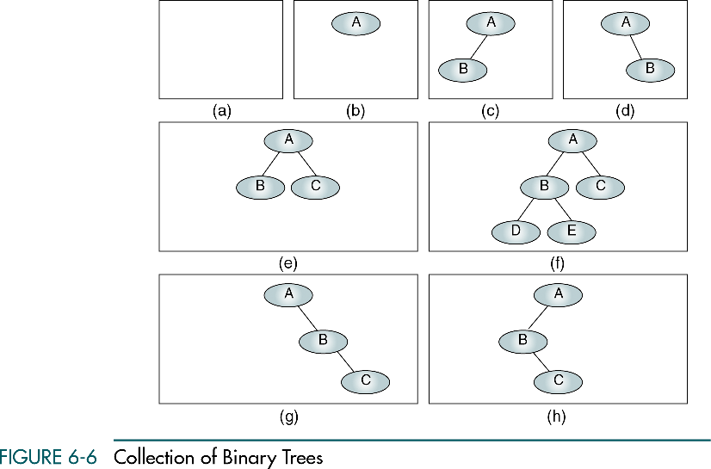
Binary Trees
A null tree is a tree with no nodes

Slide 22
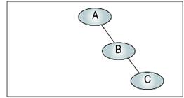
Some Properties of Binary Trees
The height of binary trees can be mathematically predicted
Given that we need to store N nodes in a binary tree, the maximum height is
Height : 3
Total node : 3
A tree with a maximum height is rare. It occurs when all of the nodes in the entire tree have only one successor.

Slide 23
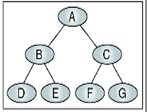
Some Properties of Binary Trees
The minimum height of a binary tree is determined as follows:
Height : 3
Total node : 7
For instance, if there are three nodes to be stored in the binary tree (N=3) then H_{min}=2.

Slide 24
Some Properties of Binary Trees
Given a height of the binary tree, H, the minimum number of nodes in the tree is given as follows:

Slide 25
Some Properties of Binary Trees
The formula for the maximum number of nodes is derived from the fact that each node can have only two child except leaf node.
Height : 3
Total nodes : 7

Slide 26
Some Properties of Binary Trees
A binary tree with N nodes has exactly N-1 edges.
The number of leaf nodes is equal to the number of nodes with two children + 1.
Total nodes : 7
Total edges : 6
Leaf nodes : 4

Slide 27
Some Properties of Binary Trees
The balance factor of a binary tree is the difference in height between its left and right sub trees:

Slide 28
Some Properties of Binary Trees
Balance of the tree

Slide 29
Complete binary trees
A complete binary tree is tree in which all the leaves are at same level and any non-leaf node have exactly two children.
The total number of nodes in complete binary trees are 2^{h} – 1.
Total number of leaf nodes in complete binary trees are 2^{h-1} .
Non leaf node = 2^{h-1} – 1.
At each level there are exactly 2^{L} number of nodes.

Slide 30
Complete binary trees
A
B
C
E
F
G
H

Slide 31
strictly binary trees
When every non-leaf node in binary tree is filled with left and right subtrees, then a tree is called strictly binary tree.
In other word a node have either two child node or zero child node at all.
A strictly binary tree with N leaves always have 2N-1 nodes.

Slide 32
strictly binary trees
A
B
C
E
F

Slide 33
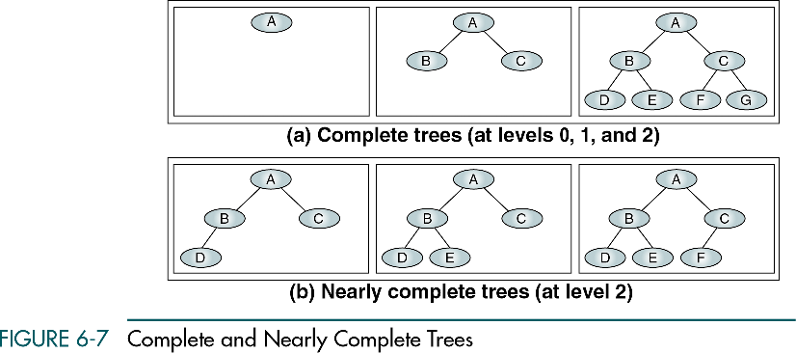
strictly binary trees

Slide 34
Representation of a trees
Array representation
Linked List representation
A
B
C
E
F
G
H
I
K

Slide 35
Array Representation of a trees
A
B
C
E
F
G
H
NULL
NULL
I
K
NULL
NULL
NULL
NULL
0 | 1 | 2 | 3 | 4 | 5 | 6 | 7 | 8 | 9 | 10 | 11 | 12 | 13 | 14
A | B | C | E | F | G | H |  |  | I | K

Slide 36
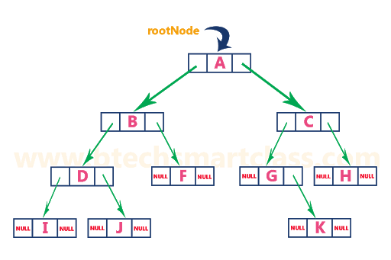
Linked Representation of a trees

Slide 37
Binary trees Transversal
A binary tree traversal requires that each node of the tree be processed once and only once in a predetermined sequence.

Slide 38
Trees Transversal
In-order traversal
Left sub tree -------- root--------right sub tree
Pre-order traversal
root-------- Left sub tree -------- right sub tree
Post order traversal
Left sub tree-------right sub tree -------- root

Slide 39
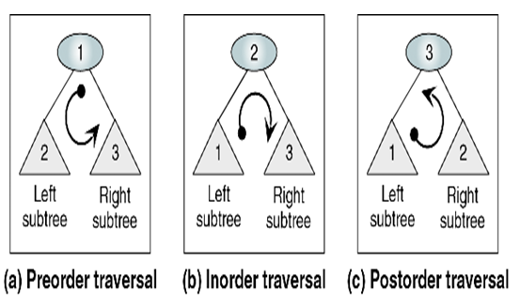
Trees Transversal

Slide 40
Trees Transversal
A
B
C
E
F
G
H

Slide 41
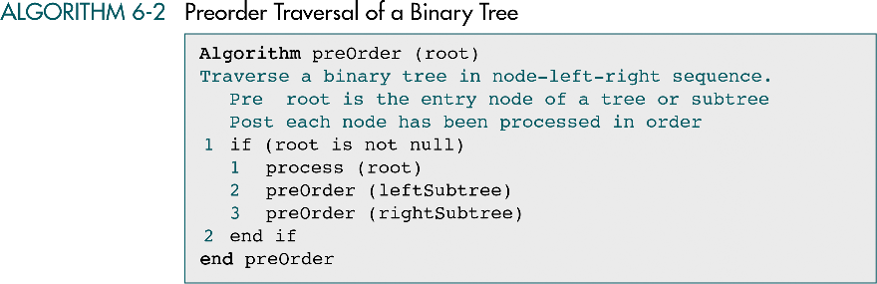
Trees Transversal

Slide 42
Trees Transversal
Root
A
B
C
E
F
G
H

Slide 43
Trees Transversal
A
Root
B
C
E
F
G
H
Left Sub tree

Slide 44
Trees Transversal
A
Root
B
C
Left
E
F
G
H
Left Sub tree

Slide 45
Trees Transversal
A
Root
B
C
Left
Right
E
F
G
H

Slide 46
Trees Transversal
A
Root
Root
B
C
Left
Right
E
F
G
H
Left
Left Sub tree
Right Sub tree

Slide 47
Trees Transversal
A
Root
Root
B
C
Left
Right
E
F
G
H
Left
Left Sub tree
Right Sub tree

Slide 48

Trees Transversal
A
Root
B
C
Root
Left
Right
E
F
G
H
Left Sub tree
Left
Right Sub tree
Preorder :
A B E F C G H

Slide 49
Find the preorder traversal of following tree
A
B
C
E
F
G
H
I
K
A,B,E,F,I,K,C,G,H

Slide 50
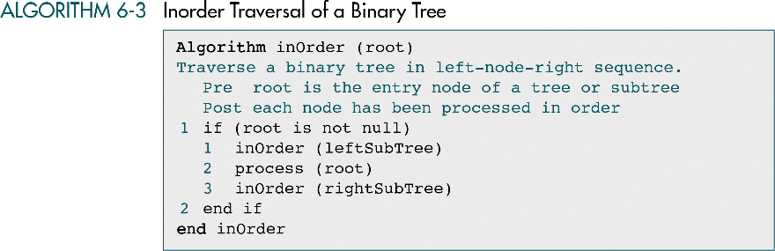
Inorder traversal

Slide 51
Find the Inorder traversal of the following
A
B
C
E
F
G
H
I
K

Slide 52
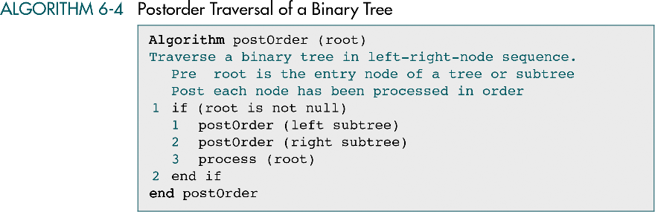
Postorder traversal Algorithm

Slide 53
Find the Postorder traversal of the following tree
A
B
C
E
F
G
H
I
K

Slide 54
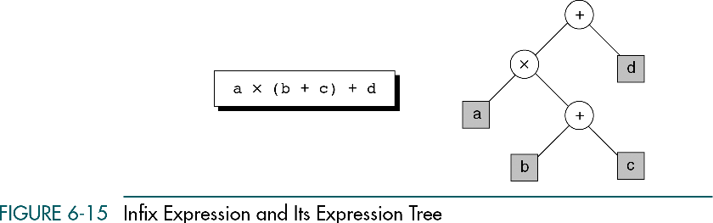
Find the Postorder traversal of the following tree

Slide 55
Reconstruct Binary tree
We can reconstruct binary from following two traversals
In order traversal
Pre-order or post order traversal
Lets reconstruct binary from following two traversals
In order traversal: XBGDHAEICJFK
Pre-order traversal: ABXDGHCEIFJK
Lets reconstruct binary from following two traversals
In order traversal: bgdaecf
Pre-order traversal: gdbefca

Slide 56
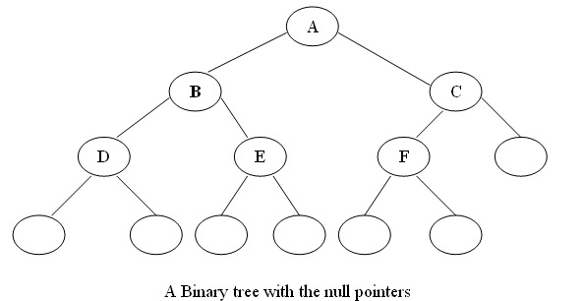
Threaded Binary tree
In a linked representation of a binary tree, the number of null links (null pointers) are actually more than non-null pointers.
These null links can be replace with pointers called threads.
Consider the following binary tree:

Slide 57
Threaded Binary tree
A left null link of a node is replaced with the address of its inorder predecessor.
And right null link of a node is replace with the address of its inorder successor.
In previous example there are 7 null pointers & 5 Actual.
We can generalize it that for any binary tree with n nodes there will be (n+1) null pointers and 2n total pointers.
The objective here to make effective use of these null pointers.

Slide 58
Threaded Binary tree
And binary tree with such pointers are called threaded binary tree.
In the memory representation of a threaded binary tree, it is necessary to distinguish between a normal pointer and a thread.

Slide 59
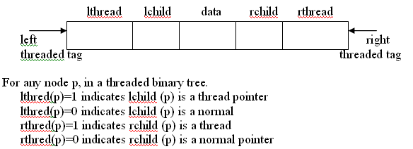
Threaded Binary tree
Therefore we have an alternate node representation for a threaded binary tree which contains five fields as show bellow

Slide 60
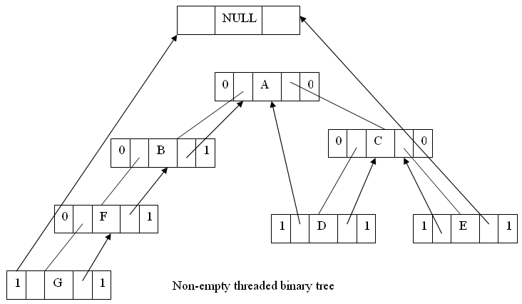
Threaded Binary tree

Slide 61
Threaded tree Transversal
6
8
3
1
5
7
11
9
13

Slide 62
Threaded tree Transversal
We start at the leftmost node in the tree, print it, and follow its right thread
If we follow a thread to the right, we output the node and continue to its right
If we follow a link to the right, we go to the leftmost node, print it, and continue

Slide 63
Threaded tree Transversal
Output
1
6
8
3
1
5
7
11
9
13
Start at leftmost node, print it

Slide 64
Threaded tree Transversal
Output
1
3
6
8
3
1
5
7
11
9
13
Follow thread to right, print node

Slide 65
Threaded tree Transversal
Output
1
3
5
6
8
3
1
5
7
11
9
13
Follow link to right, go to leftmost node and print

Slide 66
Threaded tree Transversal
Output
1
3
5
6
6
8
3
1
5
7
11
9
13
Follow thread to right, print node

Slide 67
Threaded tree Transversal
Output
1
3
5
6
7
6
8
3
1
5
7
11
9
13
Follow link to right, go to leftmost node and print

Slide 68
Threaded tree Transversal
Output
1
3
5
6
7
8
6
8
3
1
5
7
11
9
13
Follow thread to right, print node

Slide 69
Threaded tree Transversal
Output
1
3
5
6
7
8
9
6
8
3
1
5
7
11
9
13
Follow link to right, go to leftmost node and print

Slide 70
Threaded tree Transversal
Output
1
3
5
6
7
8
9
11
6
8
3
1
5
7
11
9
13
Follow thread to right, print node

Slide 71
Threaded tree Transversal
Output
1
3
5
6
7
8
9
11
13
6
8
3
1
5
7
11
9
13
Follow link to right, go to leftmost node and print

Slide 72
Advantage of Threaded Binary tree
The traversal operation is more faster than that of its unthreaded version.
Because with threaded binary tree non-recursive implementation is possible which can run faster and does not require the botheration of stack management.
we can efficiently determine the predecessor and successor nodes starting from any node.

Slide 73
Disadvantage of Threaded Binary tree
Insertion and deletion from a threaded tree are very time consuming operation compare to non-threaded binary tree.
This tree require additional bit to identify the threaded link.

Slide 74
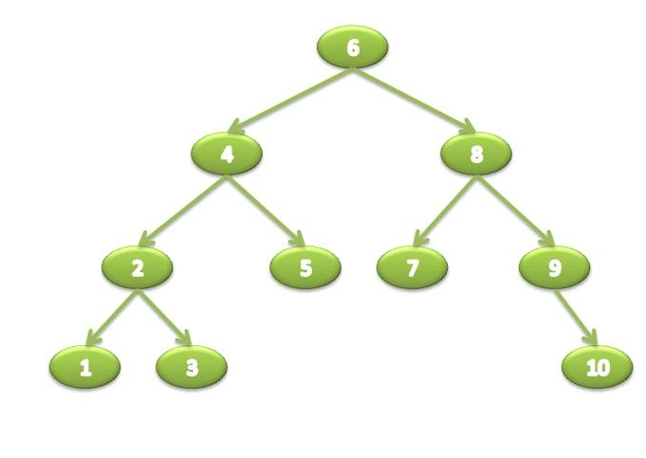
Binary Search Tree

Slide 75
Binary Search Tree
The node in extreme left will be the smallest node in the tree.
The node in the extreme right will be the largest node in the tree.
Since nodes in binary search trees are ordered the time needed to search an element is greatly reduced.

Slide 76
Operation on Binary Search Tree
Search
Insertion
Deletion

Slide 77
Search
Search function is used to find whether a value is present in a tree or not.
This process begins at the root node.
The function first checks if the binary tree is empty.
Then it checks if the value to be searched is less than or greater than the node.
If the value is less than it will go to the left sub tree else to the right sub tree.

Slide 78
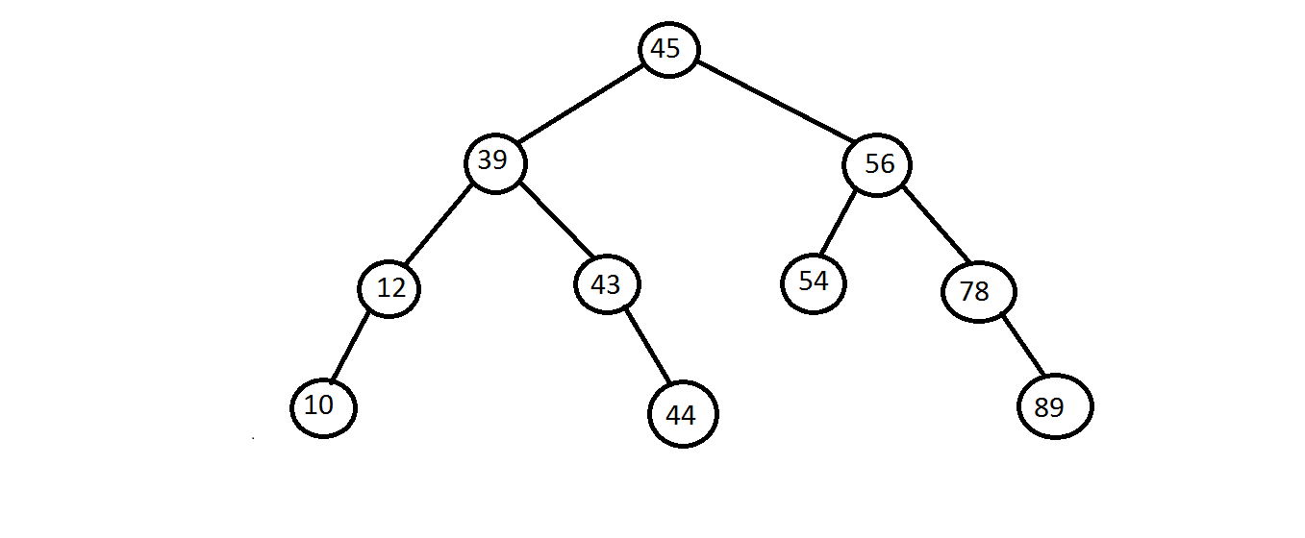
Search node 44

Slide 79
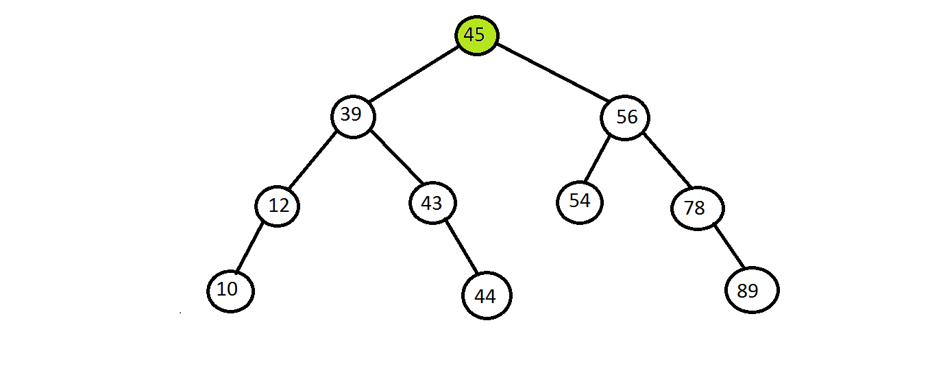
Search node 44

Slide 80
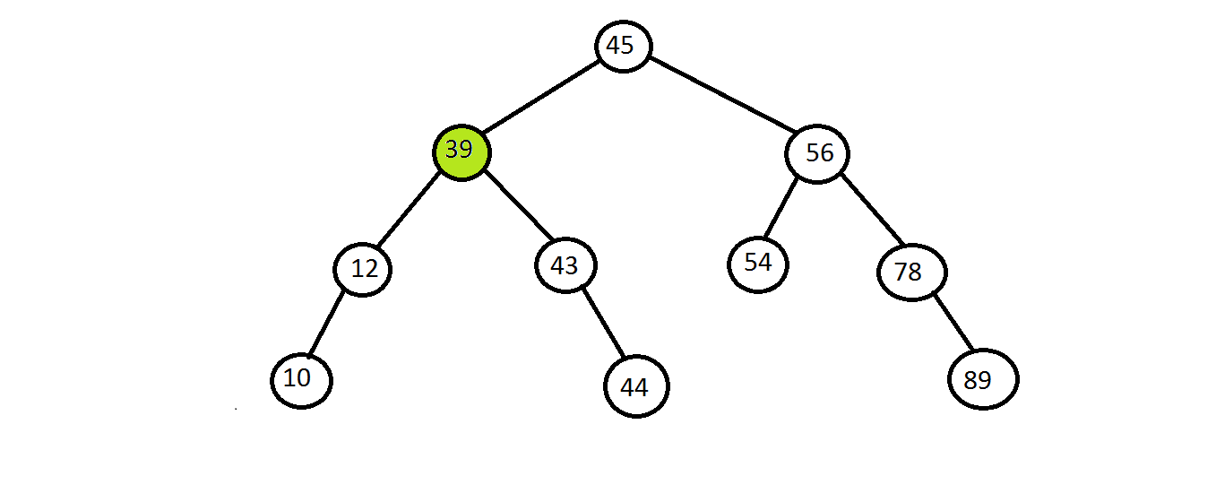
Search node 44

Slide 81
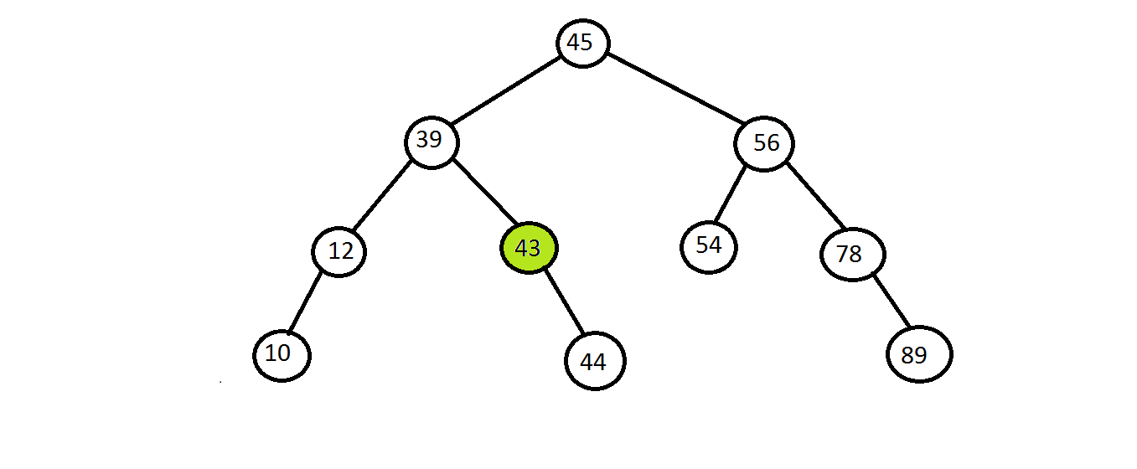
Search node 44

Slide 82
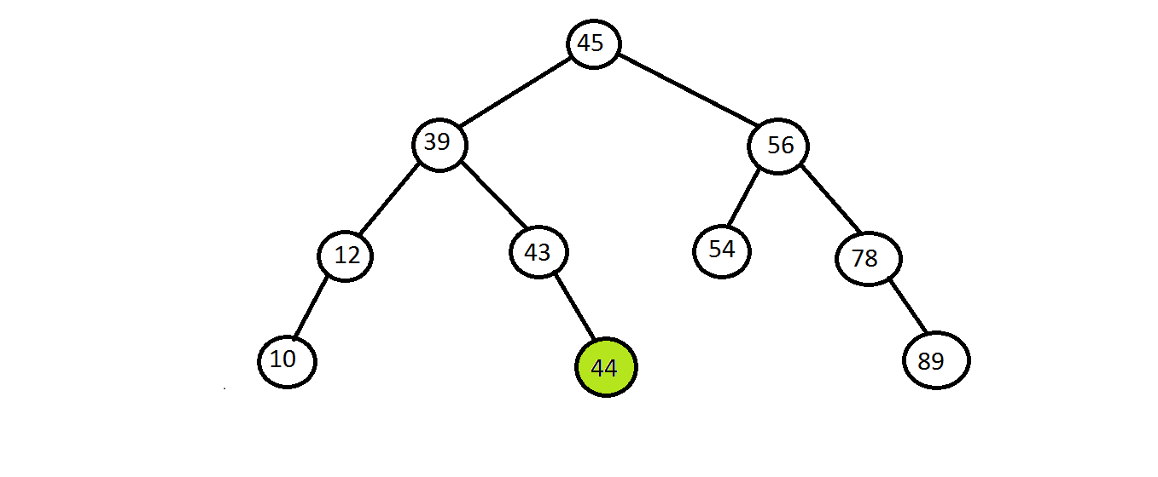
Search node 44

Slide 83
Insert
Insert is used to add a new node with a given value at the correct position in the binary search tree.
The insert function continues moving down the tree until it reaches a leaf node.
If the new node’s value is greater than the parent node then the new node is inserted in right sub tree else in the left sub tree.

Slide 84
Insert Value 20

Slide 85
Insert Value 20

Slide 86
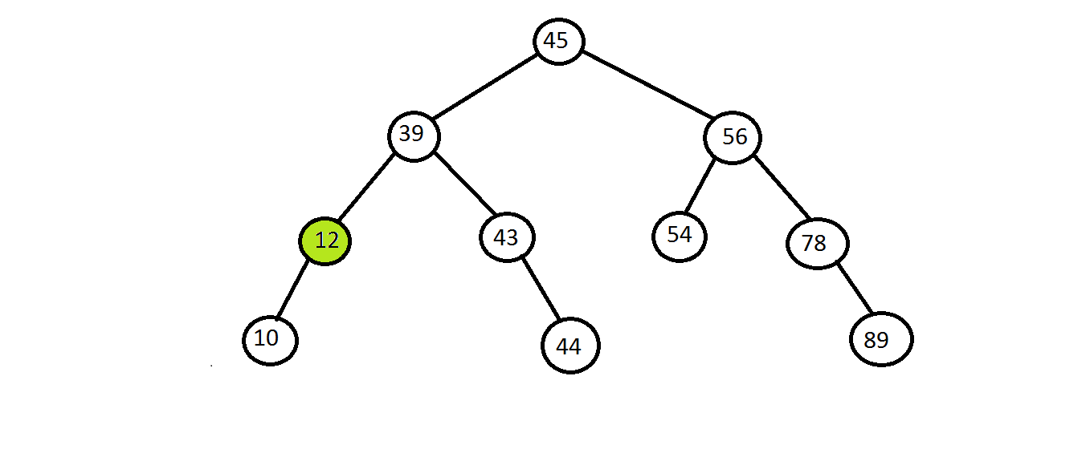
Insert Value 20

Slide 87
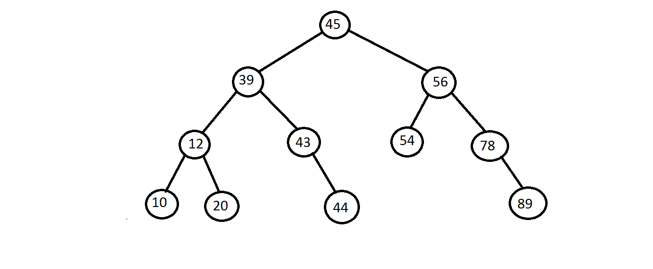
Insert Value 20

Slide 88
Insert Value 20

Slide 89
Deletion
1) Deleting a node that has no children.
2) Deletion a node that has one child.
3) Deletion a node that has two children.

Slide 90
Deletion

Slide 91
Deletion node 54

Slide 92
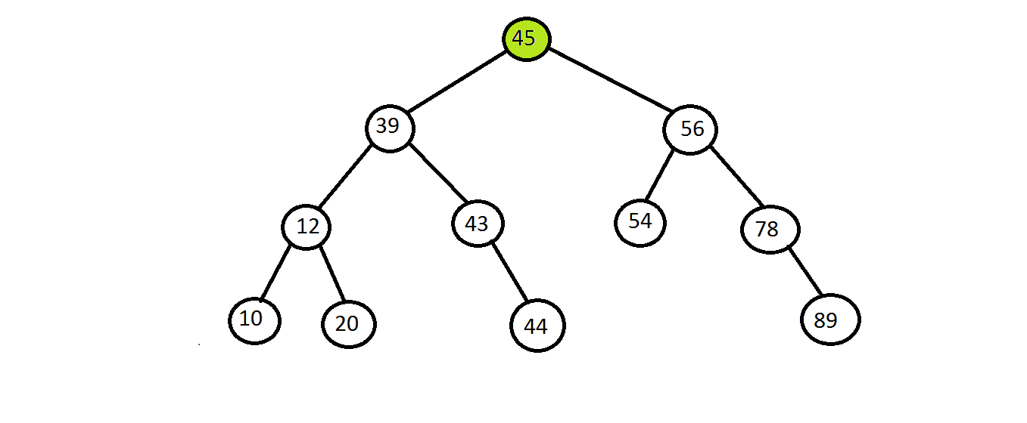
Deletion node 54

Slide 93
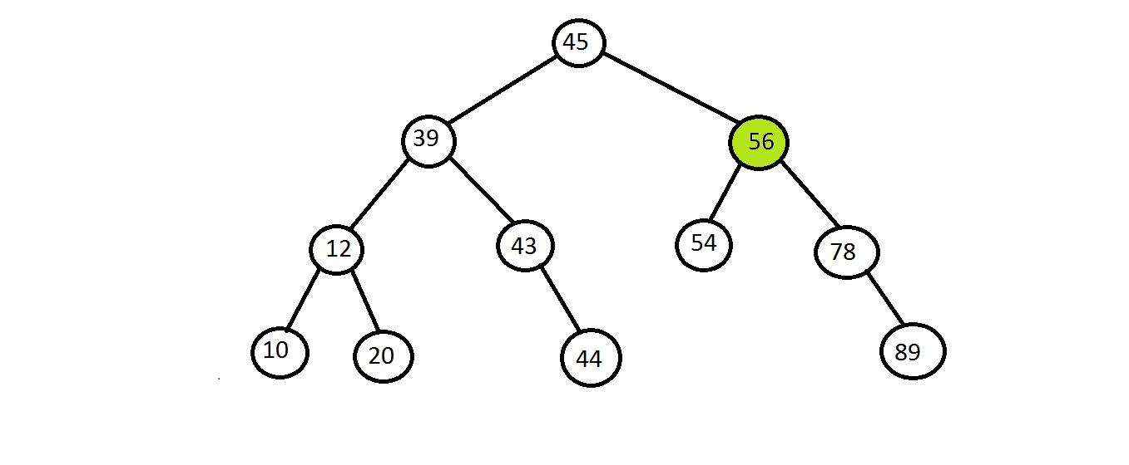
Deletion node 54

Slide 94
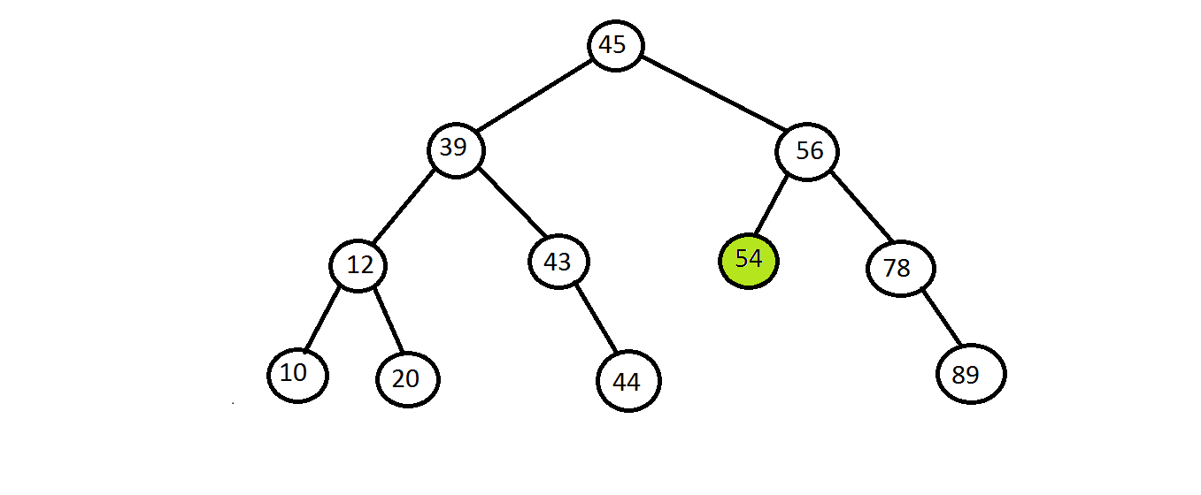
Deletion node 54

Slide 95
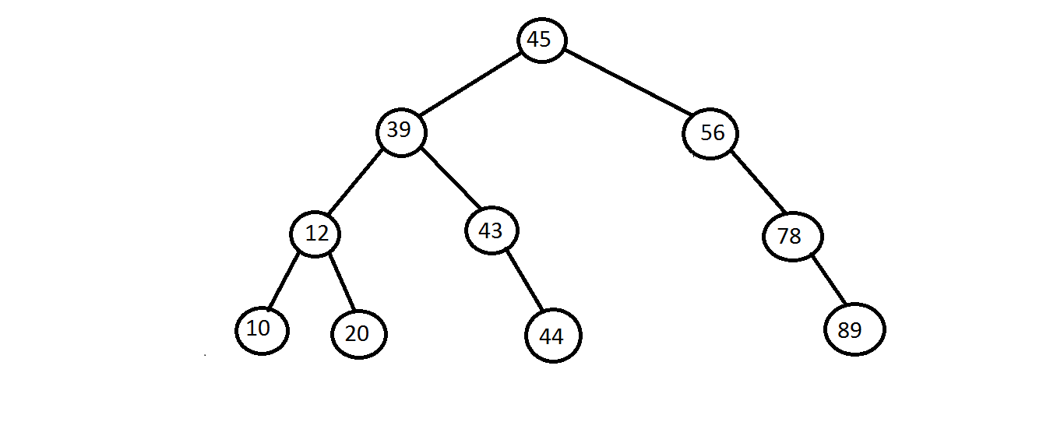
Deletion node 54

Slide 96
Deletion a node with one child
To handle this case node’s child is set to be child of node’s parent.
If node was left child of its parent then node’s child becomes left child of node’s parent.
If node was right child of it’s parent then node’s child becomes right child of node’s parent.

Slide 97

Deletion a node 78

Slide 98

Deletion a node 78

Slide 99

Deletion a node 78

Slide 100
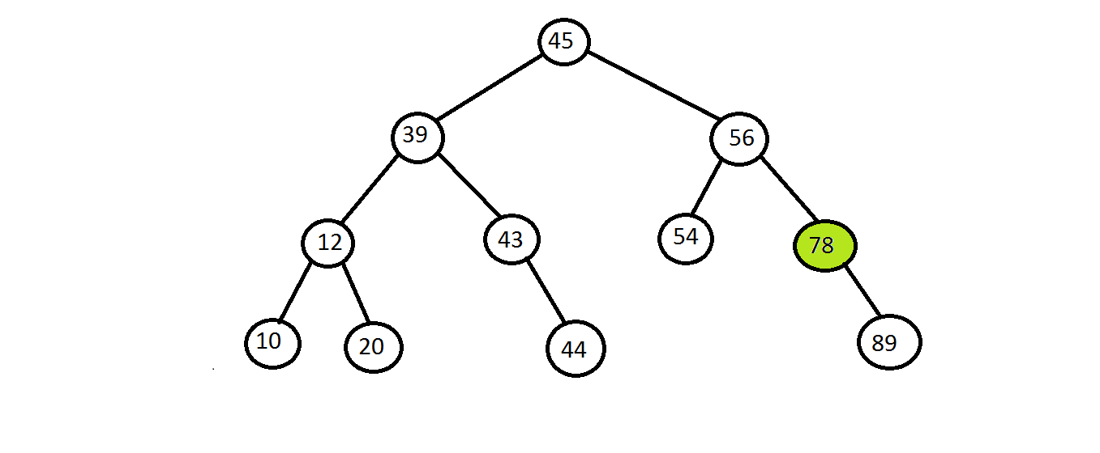
Deletion a node 78

Slide 101
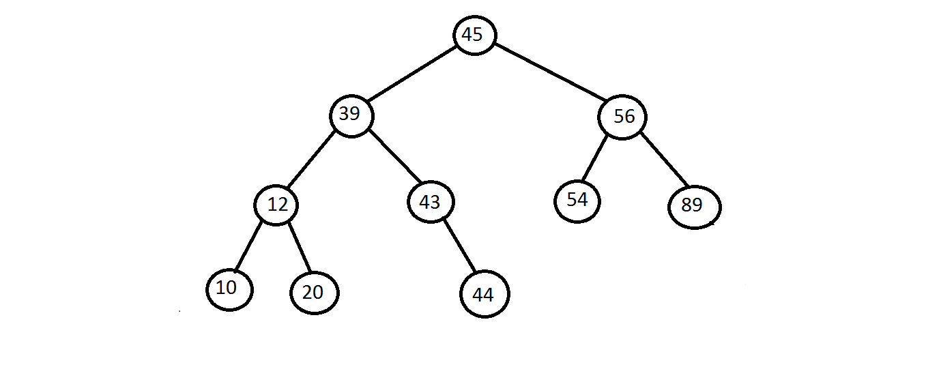
Deletion a node 78

Slide 102
Deletion a node 78

Slide 103
Deletion a node with Two child
To handle this case replace node’s value with its IN ORDER PREDECESSOR or IN ORDER SUCCESSOR.
In order predecessor is right most child of left sub tree.
In order successor is left most child of right sub tree.

Slide 104
Deletion a node with 45

Slide 105
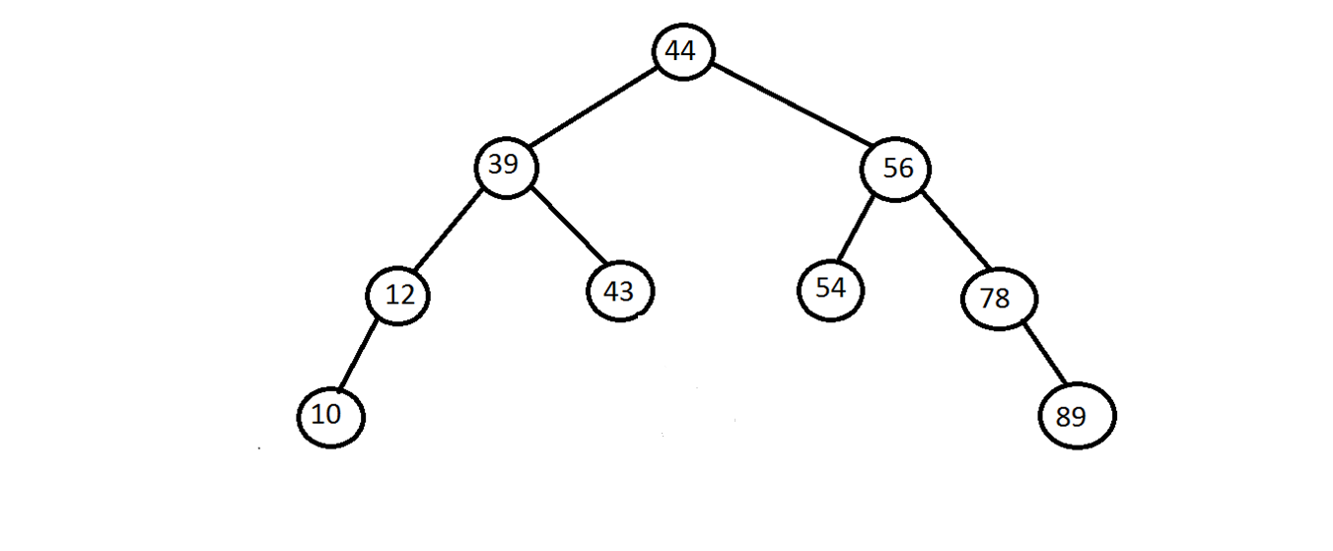
Deletion a node with 45

Slide 106
UNIT 4
Tree
Prof. Pintu Chauhan, Assistant Professor
Computer Science & Engineering

Slide 107
Topic-2
AVL Tree

Slide 108
Balanced Tree
Binary Search Tree gives advantage of Fast Search, but sometimes in few cases we are not able to get this advantage. E.g. look into worst case BST
Balanced binary trees are classified into two categories
Height Balanced Tree (AVL Tree)
Weight Balanced Tree
Worst search time cases
for Binary Search Tree
50
20
40
30
30
40
20
50

Slide 109
Height Balanced Tree (AVL Tree)
A Balance factor of a node | H_{L} - H_{R}|<=1, where H_{L,} H_{R} are heights of left and right sub-tree respectively
Permissible balance factors:
A Left-High (balance factor +1) The left-sub tree is one level taller than the right-sub tree
Balanced (balance factor 0) The left and right sub-trees are both the same heights
Right-High (balance factor -1) The right sub-tree is one level taller than the left-sub tree.
In height balanced tree, each node must be in one of these states
If there exists a node in a tree where this is not true, then such a tree is called Unbalanced

Slide 110
AVL Tree
0
-1
+1
-1
0
0
0
0
0
-1
+1
+1
0
0
-1
0
0
0

Slide 111
AVL Tree
Critical Node
Unbalanced Node
Critical Node
Unbalanced Node
0
-1
-1
0
+1
0
0
Sometimes tree becomes unbalanced by inserting or deleting any node
Then based on position of insertion, we need to rotate the unbalanced node
Rotation is the process to make tree balanced

Slide 112
AVL Tree Rotation
The following operations are performed on AVL tree...
Search
Insertion
Deletion

Slide 113
AVL Tree Rotation
There are four rotations and they are classified into two types.
AVL Tree Rotation
Single Rotation
Double Rotation
Left Rotation
(LL Rotation)
Right Rotation
(RR Rotation)
Left Right Rotation
(LR Rotation)
Right Left Rotation
(RL Rotation)

Slide 114
Operation on an AVL
In AVL tree, after performing operations like insertion and deletion we need to check the balance factor of every node in the tree. Permissible balance factors:
If every node satisfies the balance factor condition then we conclude the operation otherwise we must make it balanced.
If there exists a node in a tree where this is not true, then such a tree is called Unbalanced
Rotation operations are used to make the tree balanced.
Rotation is the process of moving nodes either to left or to right to make the tree balanced.

Slide 115
Single Left Rotation (LL Rotation )
In LL Rotation, every node moves one position to left from the current position.
To understand LL Rotation, let us consider the following insertion operation in AVL Tree.
-2
Insert 8, 10, 12
8
-2
0
8
10
10
-1
10
-1
0
0
0
8
12
0
12
12
To make balanced we use LL Rotation which moves nodes one position to left
After LL Rotation Tree is balanced
Tree is imbalanced

Slide 116
Single Right Rotation (RR Rotation )
In RR Rotation, every node moves one position to right from the current position.
To understand RR Rotation, let us consider the following insertion operation in AVL Tree.
Insert 12, 10, 8
+2
12
+2
0
12
10
+1
+1
10
0
0
10
8
12
0
8
8
0
To make balanced we use RR Rotation which moves nodes one position to Right
After RR Rotation Tree is balanced
Tree is imbalanced

Slide 117
Left Right Rotation (LR Rotation )
The LR Rotation is a sequence of single left rotation followed by a single right rotation
In LR Rotation, at first, every node moves one position to the left and one position to right from the current position.
To understand LR Rotation, let us consider the following insertion operation in AVL Tree.
Insert 12, 8, 10
12
+2
+2
0
12
+2
12
10
-1
8
+1
0
0
-1
8
10
8
12
0
0
10
0
10
8
After LR Rotation Tree is balanced
Tree is imbalanced
LL Rotation
RR Rotation

Slide 118
Right Left Rotation (LR Rotation )
The RL Rotation is a sequence of single right rotation followed by a single left rotation
In RL Rotation, at first, every node moves one position to the right and one position to left from the current position.
To understand RL Rotation, let us consider the following insertion operation in AVL Tree.
Insert 8, 12, 10
-2
8
-2
12
-2
12
0
10
+1
-1
0
0
+1
12
8
10
8
12
10
0
10
0
0
8
After RL Rotation Tree is balanced
Tree is imbalanced
RR Rotation
LL Rotation

Slide 119
AVL Tree Rotation
The following operations are performed on AVL tree...
Search
Insertion
Deletion

Slide 120
Search Operation in AVL Tree
In an AVL tree, the search operation is performed with O(log n) time complexity.
The search operation in the AVL tree is similar to the search operation in a Binary search tree.
We use the following steps to search an element in AVL tree.
Step 1 - Read the search element from the user.
Step 2 - Compare the search element with the value of root node in the tree.
Step 3 - If both are matched, then display "Given node is found!!!" and terminate the function
Step 4 - If both are not matched, then check whether search element is smaller or larger than that node value.

Slide 121
Search Operation in AVL Tree
Step 5 - If search element is smaller, then continue the search process in left subtree.
Step 6 - If search element is larger, then continue the search process in right subtree.
Step 7 - Repeat the same until we find the exact element or until the search element is compared with the leaf node.
Step 8 - If we reach to the node having the value equal to the search value, then display "Element is found" and terminate the function.
Step 9 - If we reach to the leaf node and if it is also not matched with the search element, then display "Element is not found" and terminate the function.

Slide 122
Insertion Operation in AVL Tree
In an AVL tree, the insertion operation is performed with O(log n) time complexity.
In AVL Tree, a new node is always inserted as a leaf node.
The insertion operation is performed as follows.
Step 1 - Insert the new element into the tree using Binary Search Tree insertion logic.
Step 2 - After insertion, check the Balance Factor of every node.
Step 3 - If the Balance Factor of every node is 0 or 1 or -1 then go for next operation.
Step 4 - If the Balance Factor of any node is other than 0 or 1 or -1 then that tree is said to be imbalanced. In this case, perform suitable Rotation to make it balanced and go for next operation.

Slide 123
Construct an AVL tree by inserting numbers from 1 to 7
Insert 1
Insert 2
0
1
Tree is balanced
-1
1
0
Tree is balanced
2

Slide 124
Construct an AVL tree by inserting numbers from 1 to 7
Insert 3
-2
1
1
0
After LL Rotation
2
-1
2
2
0
0
0
3
1
3
3
Tree is Imbalanced
LL Rotation
Tree is Balanced

Slide 125
Construct an AVL tree by inserting numbers from 1 to 7
Insert 4
-1
2
0
-1
Tree is balanced
1
3
0
4

Slide 126
Construct an AVL tree by inserting numbers from 1 to 7
Insert 5
-1
-2
-2
2
2
0
-1
-2
-2
After LL Rotation at 3
0
0
0
1
3
2
1
3
3
0
0
0
-1
-1
1
4
4
4
Node is Imbalanced
0
0
0
0
3
5
5
5
Tree is balanced
LL Rotation at 3

Slide 127
Construct an AVL tree by inserting numbers from 1 to 7
Insert 6
Node is Imbalanced
0
-2
0
-2
2
0
2
4
2
After LL Rotation at 2
0
0
-1
0
0
0
-1
1
4
2
5
1
4
0
0
0
-1
0
0
0
-1
0
3
5
3
6
3
5
1
0
0
6
Tree is balanced
6
LL Rotation at 2

Slide 128
Construct an AVL tree by inserting numbers from 1 to 7
Insert 7
0
-1
0
After LL Rotation at 5
4
Node is Imbalanced
4
0
0
0
0
0
4
0
-2
2
5
2
5
5
0
0
0
0
0
-1
0
0
0
2
6
0
0
3
6
1
3
6
0
0
1
0
1
3
5
0
7
0
LL Rotation at 5
7
7
Tree is Balanced

Slide 129
Deletion Operation in AVL Tree
The deletion operation in AVL Tree is similar to deletion operation in BST.
But after every deletion operation, we need to check with the Balance Factor condition.
If the tree is balanced after deletion go for next operation otherwise perform suitable rotation to make the tree Balanced.

Slide 130
UNIT 4
Tree
Prof. Shyambabu PAndey, Assistant Professor
Computer Science & Engineering

Slide 131

Topic3
B & B+ Tree

Slide 132
M-Way Search Tree
Issue with Binary Search Tree (BST): Binary search tree is a good idea, but it stores only one value at each node. Suppose we have a large number of values or we want to store more than one value at one node then Binary search tree is not applicable. So, we have to go for Multiple Way Search Tree. It is also known as M -Way Search Tree or M-ary tree.
Image source : Google

Slide 133
M-Way Search Tree
M-way search tree is a tree that can have more than two children.
An m-way is tree of order m (m children) in which:
1. Each internal node (except root) can have at most m children/node and each node can contain at most m-1 value.
2. The values in each node are in ascending order.
3. The values in the first i children are smaller than the i-th value.
4. The values in the last m-i children are larger than the i-th value.

Slide 134
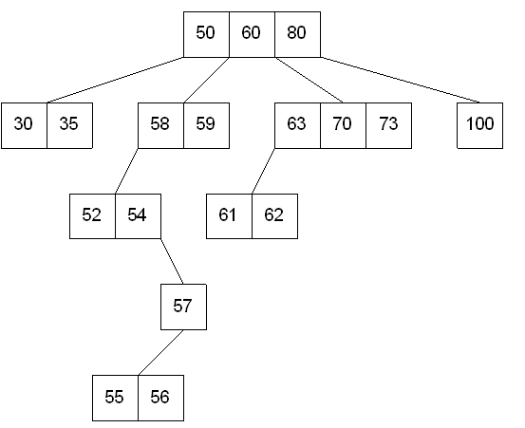
M-Way Search Tree
Example: Let us take a 4-way search tree.
Here the order of tree is 4 so the value of m is 4. We can see each node has at most 4 children and each node can contain at most 3 (m-1) nodes.

Slide 135
M-Way Search Tree
Issue with M-Way Search Tree: M-way search tree is not a height balanced tree. It will take more time for insertion and deletion operation of a node.

Slide 136
B-Tree
B Tree was developed by Bayer and McCreight in 1972 with the name Height Balanced m-way Search Tree. Later it was named as B-Tree.
A B-Tree is a height balanced m-Way search tree, In which:
If the degree of tree is m then each node (Internal node except root node) can contain at most m children/nodes and at least [m/2].
Image source : Google

Slide 137
B-Tree
If the degree of the tree is m, then each node must have at least [m/2]-1 keys and maximum of m-1 keys.
Root nodes can have a minimum of two children.
All the leaf nodes should have the same depth.
Image source : Google

Slide 138
B-Tree
Operations on B-Tree:
Searching
Insertion
Deletion
Image source : Google

Slide 139
B-Tree
Searching in B-Tree: Suppose we want to search an element ‘X’ In a B-Tree, then the following will be steps:
First of all compare ‘X’ with the first element of the root node in the tree.
If comparison is matched, then display "Given element is found" and terminate the function.
If comparison is not matched, then check ‘X’ is smaller or larger than that key value (That means first element of root node).
Image source : Google

Slide 140
B-Tree
4. If ‘X’ is smaller, then go to the left subtree and continue the search process.
5. If ‘X’ is larger, then compare ‘X’ with the next key value in the same node and repeat steps 2, 3, 4 and 5 until we find the exact match or until the ‘X’ is compared with the last key value in the leaf node.
6. If the last key value in the leaf node is also not matched then display "Element is not found" and terminate the function.
Image source : Google

Slide 141
B-Tree
Construct a B-Tree of order 3 by using following key values 10, 20, 30, 40, 50, 60, 70, 80, 90, 100.
Here order of B-Tree is 4. So m = 4
No. of at most children of internal node except root node = m = 4
No. of at least children node of internal node except root node = m/2 = 2
No. of at most key value at every node of tree= m-1 = 3
No. of at least key value at every node of tree= m/2-1 = 1
Image source : Google

Slide 142


B-Tree
Insert 10
Insert 20
Image source : Google

Slide 143

B-Tree
Insert 30
Image source : Google

Slide 144
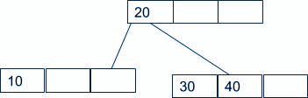
B-Tree
Insert 40
Image source : Google

Slide 145

B-Tree
Insert 60
Image source : Google

Slide 146

B-Tree
Insert 70
Image source : Google

Slide 147
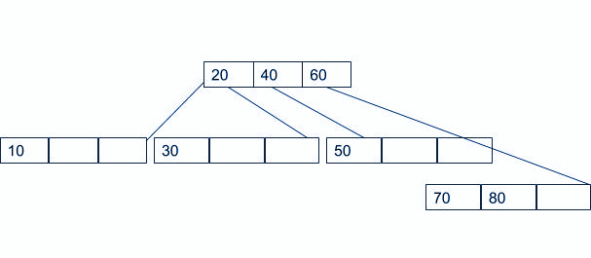
B-Tree
Insert 80
Image source : Google

Slide 148
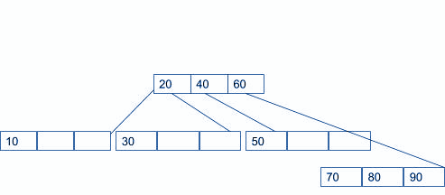
B-Tree
Insert 90
Image source : Google

Slide 149
B-Tree
Time Complexity:
Best case : O(1) (constant time). When a key is inserted in the root node, it will take constant time for insertion.
Average case : O(logn) (logarithm time). When a key is inserted in the internal node then, it will take logarithm time for insertion.
Worst case : O(logn) (logarithm time). When a key will be inserted in the leaf node, it will take logarithm time for insertion.
Image source : Google

Slide 150
B-Tree
Deletion in B-Tree:
Apply the search operation in B-Tree and find the target key in the nodes.
After finding the location of the target key, There are two conditions based on the location of the target key.
a. If the target key is in the leaf node:
1. If the target key is in the leaf node and the number of keys are more than min keys in the node. Deleting the target key does not violate any rule of B-Tree, so directly delete the target key.
Image source : Google

Slide 151
B-Tree
2. If the target is in leaf node and it has min key nodes, then Deleting of target key will violate the property of B Tree.
Target node can borrow key from immediate left node, or immediate right node (sibling)
The sibling will say yes if it has more than minimum number of keys
The key will be borrowed from the left sibling node, the max value will be transferred to the target node. Or, The key will be borrowed from the right sibling node, the minimum value will be transferred to the target node.
Image source : Google

Slide 152
B-Tree
3. Target is in the leaf node, but no siblings have more than min number of keys
If both the immediate sibling nodes already have a minimum number of keys, then merge the node with either the left sibling node or the right sibling node. This merging is done through the parent node.
b. If the target key is in an internal node:
Either choose, in- order predecessor or in-order successor
In case the of in-order predecessor, the maximum key from its left subtree will be selected
Image source : Google

Slide 153
B-Tree
In case of in-order successor, the minimum key from its right subtree will be selected
If the target key's in-order predecessor has more than the min keys, only then it can replace the target key with the max of the in-order predecessor
If the target key's in-order predecessor does not have more than min keys, look for the in-order successor's minimum key.
If the target key's in-order predecessor and successor both have less than min keys, then merge the predecessor and successor.
But, if the sibling also has only a minimum number of keys then, merge the node with the sibling along with the parent. Arrange the children accordingly (increasing order).
Image source : Google

Slide 154
B-Tree
Example: Let us take a B tree of order 4
Here m=4
minimum number key of each node except root node: m/2-1= 1
Image source : Google

Slide 155
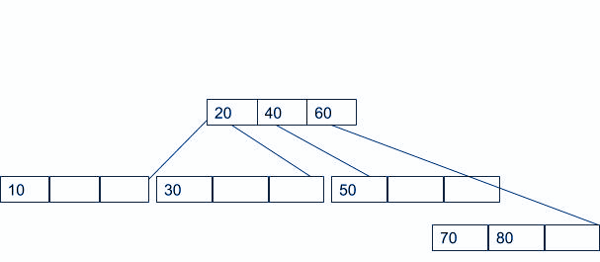
B-Tree
Delete 90
Image source : Google

Slide 156
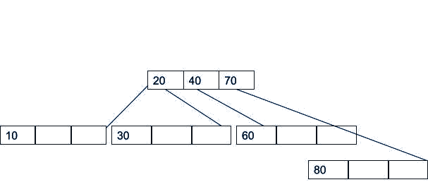
B-Tree
Delete 50
Image source : Google

Slide 157
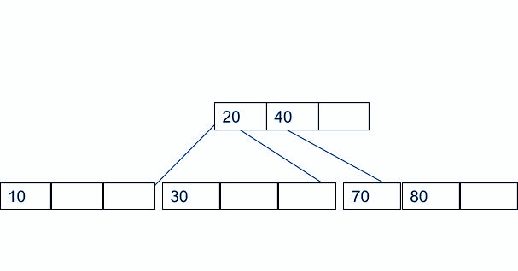
B-Tree
Delete 60
Image source : Google

Slide 158
B-Tree
Time Complexity:
Best case : O(1) (constant time). When a key is present in the root node, it will take constant time for deleting.
Average case : O(logn) (logarithm time). When a key is in the internal node then, it will take logarithm time for deleting.
Worst case : O(logn) (logarithm time). When a key will be inserted in the leaf node, it will take logarithm time for deleting.
Image source : Google

Slide 159
B+ - Tree
B+ Tree is an extension of B Tree which allows efficient insertion, deletion and search operations.
B+-Tree is a height balanced M-Way search tree, In which:
If the degree of tree is M then each node(Internal node) can contain at most m children/nodes and at least [M/2].
If the degree of the tree is M, then each node can have at least [m/2]-1 keys and maximum of m-1 keys.
Root nodes can have a minimum of two children.
All the leaf nodes should have the same depth.
Values are stored only on leaf nodes.
The leaf nodes of a B+ tree are linked together in the form of singly linked lists to make the search queries more efficient.

Slide 160
Operation on B+ - Tree
• Insertion
• Deletion
• Searching

Slide 161
Searching in B-Tree
The search operation in B+-Tree is similar to the search operation in B Search Tree. Suppose we want to search ‘X’ In a B-Tree, then the following will be steps:
First of all compare ‘X’ with the first element of the root node in the tree.
If comparison is matched, then display "Given element is found" and terminate the function.
If comparison is not matched, then check ‘X’ is smaller or larger than that key value (That means first element of root node).
If ‘X’ is smaller, then go to the left subtree and continue the search process.

Slide 162
Searching in B-Tree
If ‘X’ is larger, then compare ‘X’ with the next key value in the same node and repeat steps 2, 3, 4 and 5 until we find the exact match or until the ‘X’ is compared with the last key value in the leaf node.
If the last key value in the leaf node is also not matched then display "Element is not found" and terminate the function.

Slide 163
Time Complexity
Best case : O(1) (constant time). When a key is present in the root node, it will take constant time for searching.
Average case : O(logn) (logarithm time). When a key is in the internal node then, it will take logarithm time for searching
Worse Case : O(logn) (logarithm time). When a key will be inserted in the leaf node, it will take logarithm time for searching.

Slide 164
Insertion in B-Tree
Always, New elements will be inserted at leaf nodes in B+-Tree. Suppose we want to insert a key value ‘X’, then the following will be steps to insert a new element in B+-Tree.
1. First of all check whether the tree is empty.
2. If the tree is empty, then create a node with ‘X’ and insert it in the tree as a root node.
3. If the tree is not empty, then insert ‘X’ into the suitable leaf node by using Binary Search Tree logic.

Slide 165
Insertion in B-Tree
4. If the respective leaf node has some empty position, then insert ‘X’ in that node in ascending order of key value.
5. If the respective leaf node is full, then split that node and send a copy of the middle value to its parent. Repeat the same procedure until ‘X’ will be fixed into a node.
6. If the splitting is performed at root node then the middle value becomes a new root node for the tree and the height of the tree is increased by one.

Slide 166
Insertion in B-Tree
Example: Construct a B+-Tree of order 4 for the given elements 10, 20, 30, 40, 50, 60, 70, 80, 90.
Here m=4
Maximum number of children nodes of internal nodes: 4
Minimum number of children nodes of internal nodes: m/2= 2
Maximum number of keys on each node: m-1= 3
Minimum number of keys on each node: m/2-1= 1

Slide 167
Insertion in B-Tree
Insert 10
Insert 20, 30

Slide 168
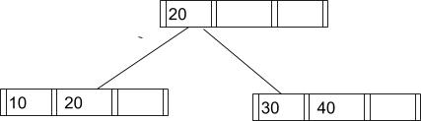
Insertion in B-Tree
Insert 40

Slide 169
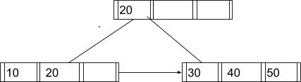
Insertion in B-Tree
Insert 50

Slide 170

Insertion in B-Tree
Insert 60

Slide 171

Insertion in B-Tree
Insert 70

Slide 172
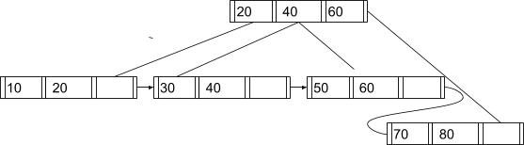
Insertion in B-Tree
Insert 80

Slide 173

Insertion in B-Tree
Insert 90

Slide 174
Deletion in B-Tree
For Deletion of a node from B+-Tree, we have to apply the following procedure:
1. Apply the search operation in B+-Tree and find the target key in the nodes.
2. After finding the position of the target key in leaf nodes, There are two conditions based on the location of the target key in leaf node.
a. The target key is present only at the leaf node not in the indexes (or internal nodes). There are two cases for it:
case 1: There is more than the minimum number of keys in the node. Simply delete the key
case 2: There is an exact minimum number of keys in the node. Delete the key and borrow a key from the immediate sibling. Add the median key of the sibling node to the parent.

Slide 175
Deletion in B-Tree
b. The key to be deleted is present in the internal nodes as well. Then we have to remove them from the internal nodes as well. There are the following cases for this situation.
Case 1: If there is more than the minimum number of keys in the node, simply delete the key from the leaf node and delete the key from the internal node as well. Fill the empty space in the internal node with the inorder successor.
Case 2: There is an exact minimum number of keys in the node. Delete the key and borrow a key from the immediate sibling. Add the median key of the sibling node to the parent.
Case 3: This case is similar to Case 1 but here, empty space is generated above the immediate parent node. After deleting the key, merge the empty space with its sibling. Fill the empty space in the grandparent node with the inorder successor.

Slide 176
Deletion in B-Tree
Example: Let take a B+-Tree order of 4.
Here m=4
Maximum number of children nodes of internal nodes: 4
Minimum number of children nodes of internal nodes: m/2= 2
Maximum number of keys on each node: m-1= 3
Minimum number of keys on each node: m/2-1= 1

Slide 177
Deletion in B-Tree
Delete 90:

Slide 178
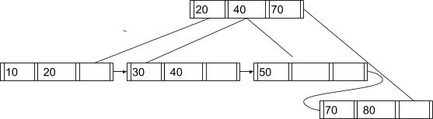
Deletion in B-Tree
Delete 60:

Slide 179
Differenence between B-Tree & B+-Tree
B-Tree | B+-Tree
Data is stored in leaf nodes as well as internal nodes. | Data is stored in leaf nodes as well as internal nodes.
Searching is a bit slower as data is stored in internal as well as leaf nodes. | Searching is faster as the data is stored only in the leaf nodes.
No redundant search keys are present. | No redundant search keys are present.
Deletion operation is complex. | Deletion operation is easy as data can be directly deleted from the leaf nodes.
Leaf nodes cannot be linked together. | Leaf nodes are linked together to form a linked list.

Slide 180


www.paruluniversity.ac.in

